Slide 1

Emotion Detection from Tweets

Slide 2
Group 25 Team Members
Kapuriya Janak (MT22032)
Mansi Patel (MT22109)
Kirtirajsinh Mahida (MT22104)
Tanay kumar (2020140)
Vijay Nain (2020582)
Abhishek (2020014)

Slide 3
Problem statements
Human emotions are personal experiences that often cause changes in behavior and physiological responses. They can be positive, such as happiness and love, or negative, such as anger and sadness. Paul Ekman identified six basic emotions: happiness, sadness, fear, anger, disgust, and surprise, which are expressed by every human being. People often use social media to share their emotions. Social media platforms suggest posts based on similar interests, but sometimes the suggestions may not be accurate because AI systems cannot understand human emotions behind user tweet. So we are building system that detect the emotion from tweets.

Slide 4
Motivation
The goal is to create an algorithm that can identify emotions in tweets to understand how people feel about certain things. Because identifying emotion of tweet is helpful to recommend post in meaningful way to the user based on state of mind. This algorithm could potentially help those with mental health issues by providing early assistance and intervention.

Slide 5
Literature Review
[1] In this research paper developed a model for emotion and sentiment analysis using tweet datasets. They used the fine-tuning BERT with 12 encoders and 8 layers each, and an extended softmax layer in emotion classifiers. The data was split in 8:1:1, undersampled to balance the dataset, and meaningless or concise tweets were removed. The model included an intensity parameter for emotion detection. The model was trained for 1-6 epochs to avoid overfitting, and Accuracy and F1 score for uncased BERT: 0.89 and 0.89, respectively, Accuracy for cased BERT was 0.90.
[2] In this paper created a dataset with both strong and weak labels, and used SVM for classification. They achieved an 84% accuracy, and then used BERT for emotion recognition. The BERTweet model provided the highest accuracy at 89%. They combined the SVM and BERT models and achieved the highest accuracy of 91% compared to other research.

Slide 6
[3] In this research paper explores a system called EmoDet2, which uses deep learning to detect emotions and sentiment in English text and classify it into Happy, Sad, Angry, and Other. The dataset used was public data, and no preprocessing was done to the raw data. The system was built by ensembling several models,the baseline model of EmoDet2, it gave the F1-score 0.57 and the best performance was achieved when BERT embeddings were used, giving an F1-score of 0.75. Additionally, word embedding models were used, and the final result showed that EmoDet2 outperformed the baseline model in detecting emotions in a conversational text.
[4]In this research paper is to predict the sentiment or attitude of users through their tweets. The paper categorizes tweets into different emotions using Naive Bayes, Support Vector Machine classifier, and K Nearest Neighbor. By analyzing Twitter data and training models, the researchers were able to classify tweets as cheerful, sad, depressing, enthusiastic, impartial, or containing no information. SVM was found to be more precise than Naive Bayes, and the model achieved 90% accuracy in classifying rage emotion.

Slide 7
[5] The researchers used WordNet-Affect and EmoSenticNet to identify words with emotional content for use as features. They tested this approach on 4000 samples (1000 from each dataset) and achieved an accuracy of 90% for the anger class using random forest and 89.28% using SVM. They used logistic regression to determine which features to use and employed random forest as their primary classifier.
[6] This paper explains a method for detecting and categorizing emotions in tweets using rules. The researchers used k-fold cross validation on 1 million tweets and achieved 85.1% accuracy. They also used techniques to eliminate noise, normalize text, and tag data. The system was evaluated based on Precision, Recall, and F-measure scores and can detect four classes of emotions: Happy-Active, Happy-Inactive, Unhappy-Active, and Unhappy-Inactive. Healthcare professionals can use this system to identify psychological disorders like anxiety or depression early on.

Slide 8
Novelty
Emojis are a popular way to express emotions in tweets, and they can help convey the emotional content of the tweet more effectively than plain text. We have replaced emojis with text to give more semantics to models. By analyzing which emojis are associated with specific emotions, we can improve the accuracy of detecting emotions in tweets. Use of pre-trained large language models such as BERT have shown promise in natural language processing with fine-tuning them on a large corpus of tweets can further improve their accuracy in emotion detection.

Slide 9
Methodology
Various researchers have used machine learning models like SVM and Decision tree and NLP models like BERT, to classify emotions in tweets. The highest accuracy achieved by any model was 91%. To increase accuracy, a paper published in 2022 used an ensemble model with various types of BERT and SVM. To further improve the model, Part of Speech tags and Dependency Parsing tree techniques were used to extract semantic features from tweets. Data preprocessing was necessary to clean the data, remove unnecessary tokens, and convert the data into vector form using the Word2vec library. The pre-processed data was then fed into various machine learning models to train and determine their performance on test set.

Slide 10
BERT and LSTM Models
We analyse the results and some previous work on this problem and we found out that the use of BERT and LSTM models used for multiclass classification on text data. BERT is a transformer-based deep learning model that learns bidirectional semantics, while LSTM is a variant of recurrent neural network that learns long-term dependencies in sentences. The BERT model was fine-tuned on dataset2 and achieved the highest accuracy of 0.9326 F1 score on the test set among all the models tested, while the LSTM model achieved an F1 score of 0.89 on the same test set. LSTM model was trained using Dropout techniques to prevent overfitting.

Slide 11
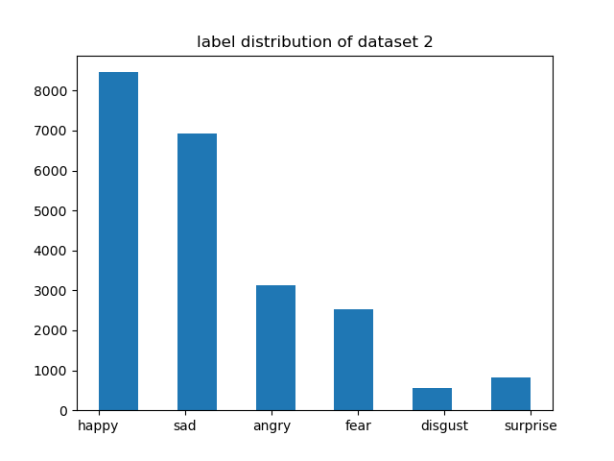
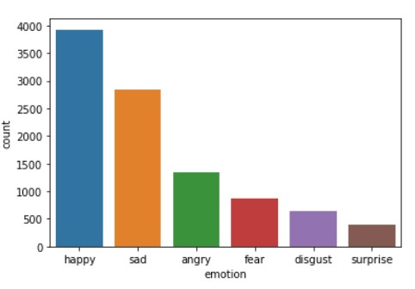
Database
we have collected twitter emotion dataset from kaggle.after that we have split the data into 80:20 ratio for training and testing purpose with stratified manner to preserve the class distribution on both splits.
Dataset1 size = 10017 samples | Dataset2 size = 22408 samples

Slide 12
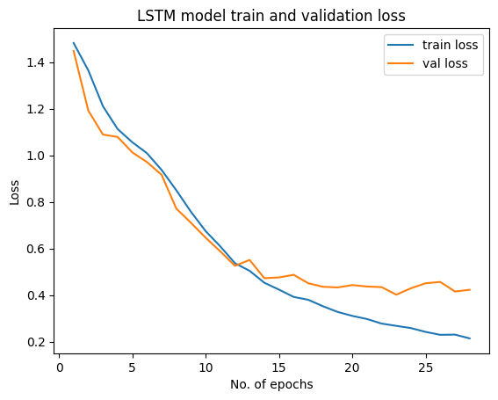
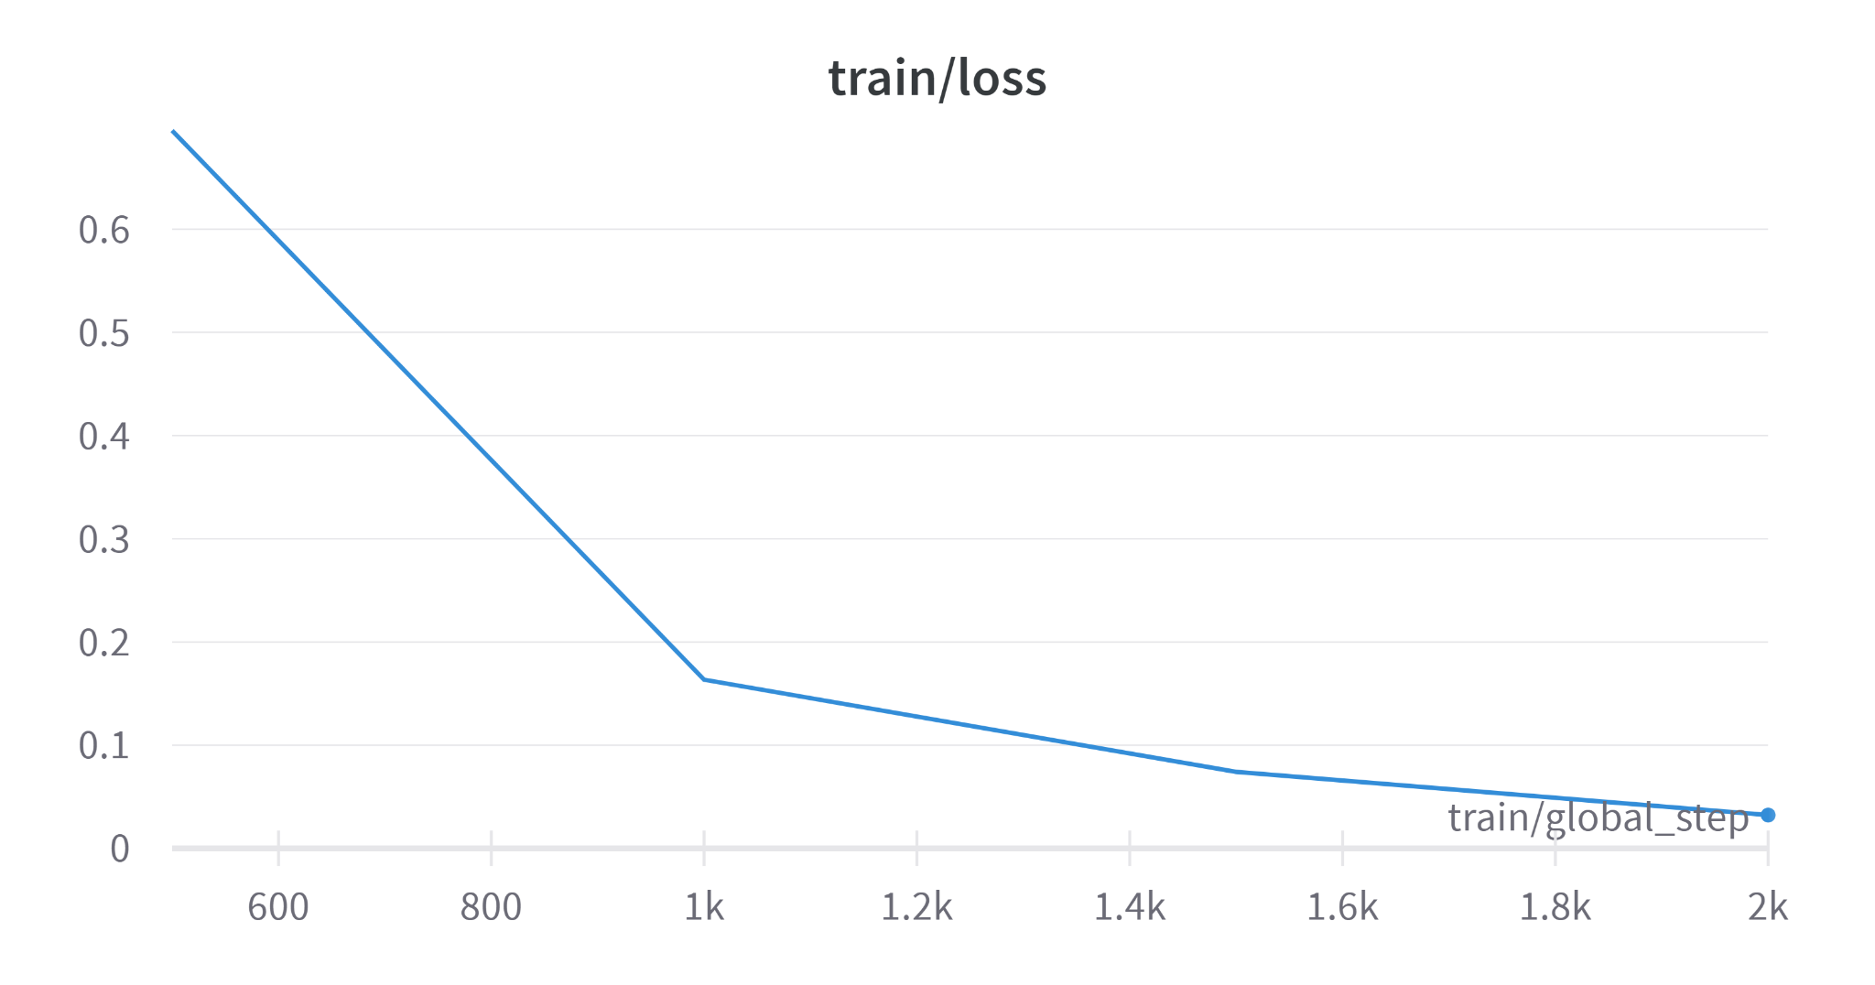
Loss plots of BERT and LSTM

Slide 13
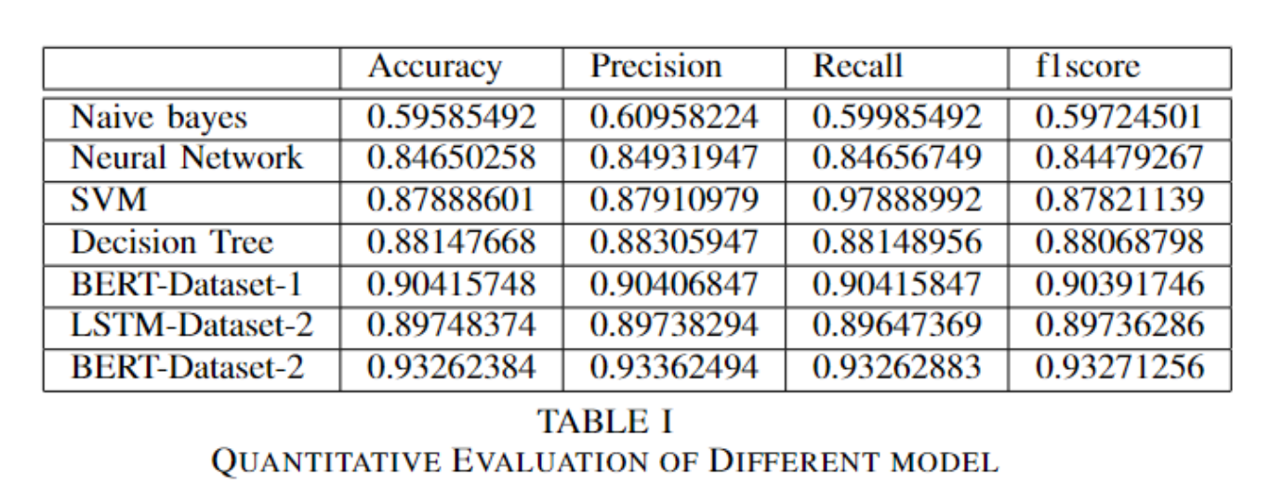
Quantitative Results of all model

Slide 14
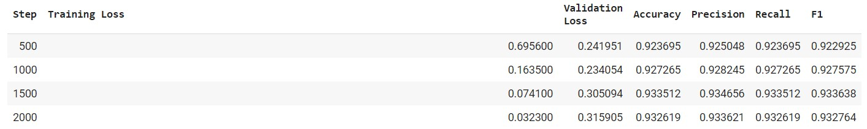
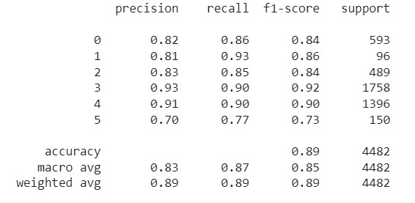
BERT and LSTM result

Slide 15
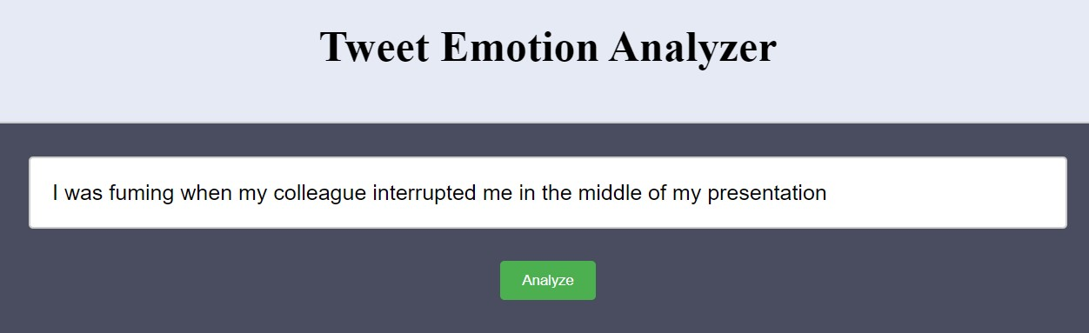
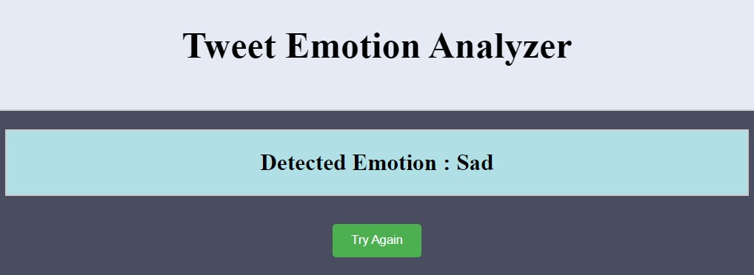
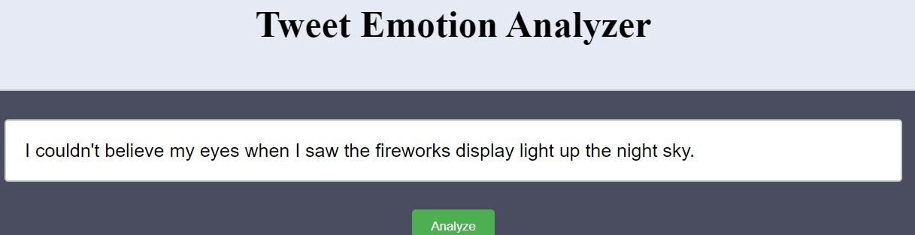
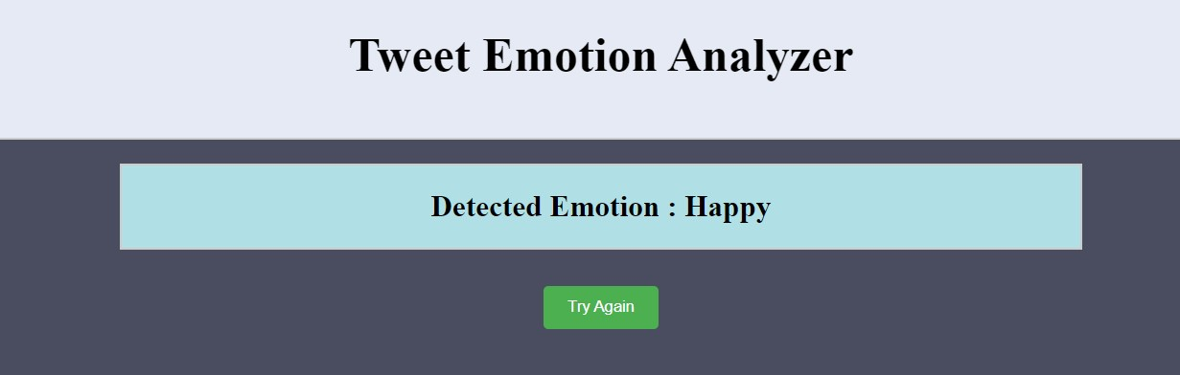
System Before Improvement

Slide 16
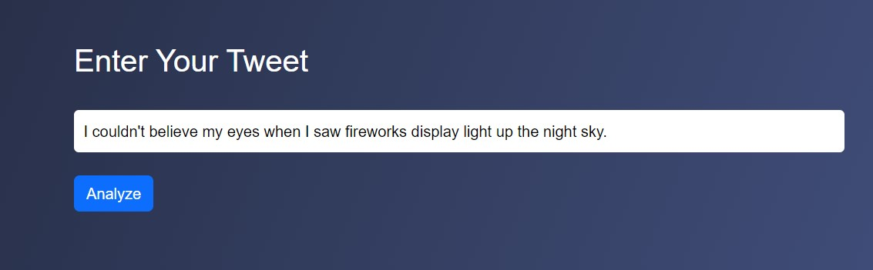
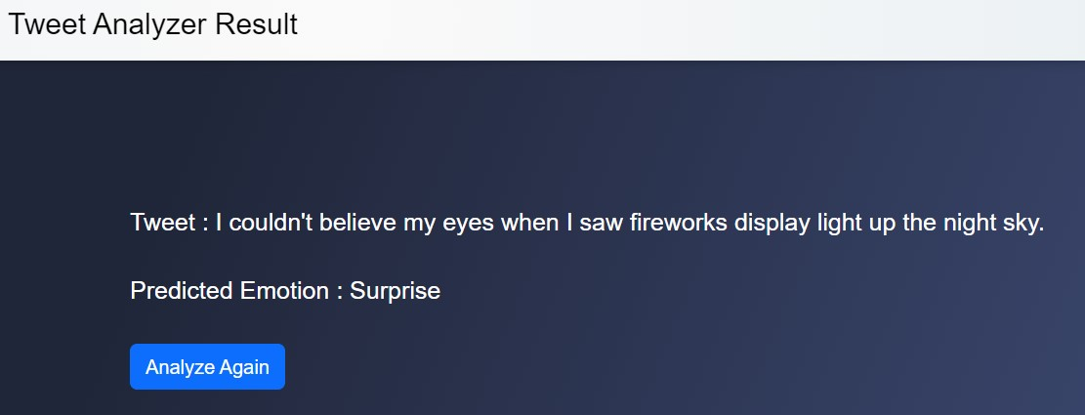
System after Improvement

Slide 17
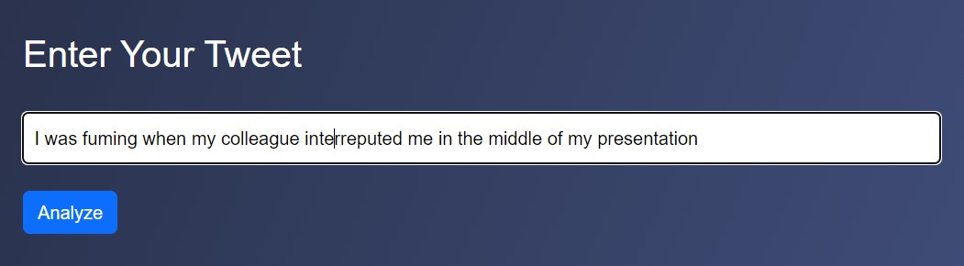
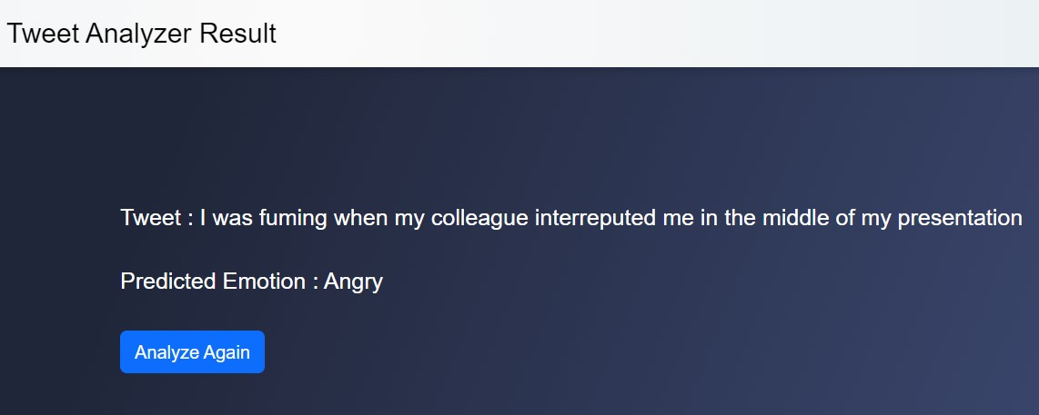
System after Improvement

Slide 18

Contribution
All the team member are contributed equally. Janak , Mansi and Kirtirajsinh worked on the Data preprocessing, modeling and Project Report while Tanay , Abhishek and Vijay has worked on model UI , PPT and model Deployment.

